Slide 1


Setting up an AWS IAM Admin User

Slide 2

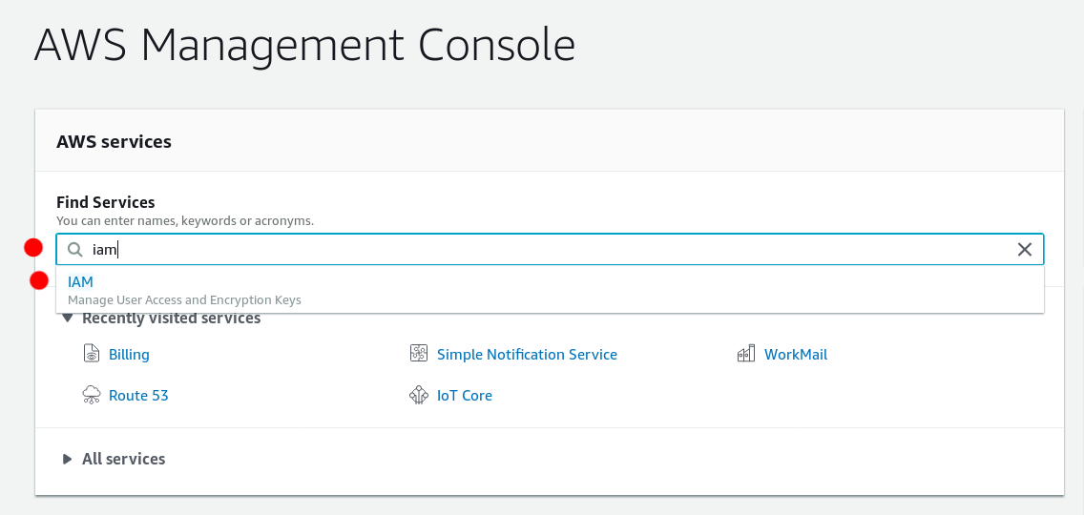
Setting up Users and Groups
Login to the AWS console
Type "iam" in the find services field
Click "IAM" from the drop down list

Slide 3
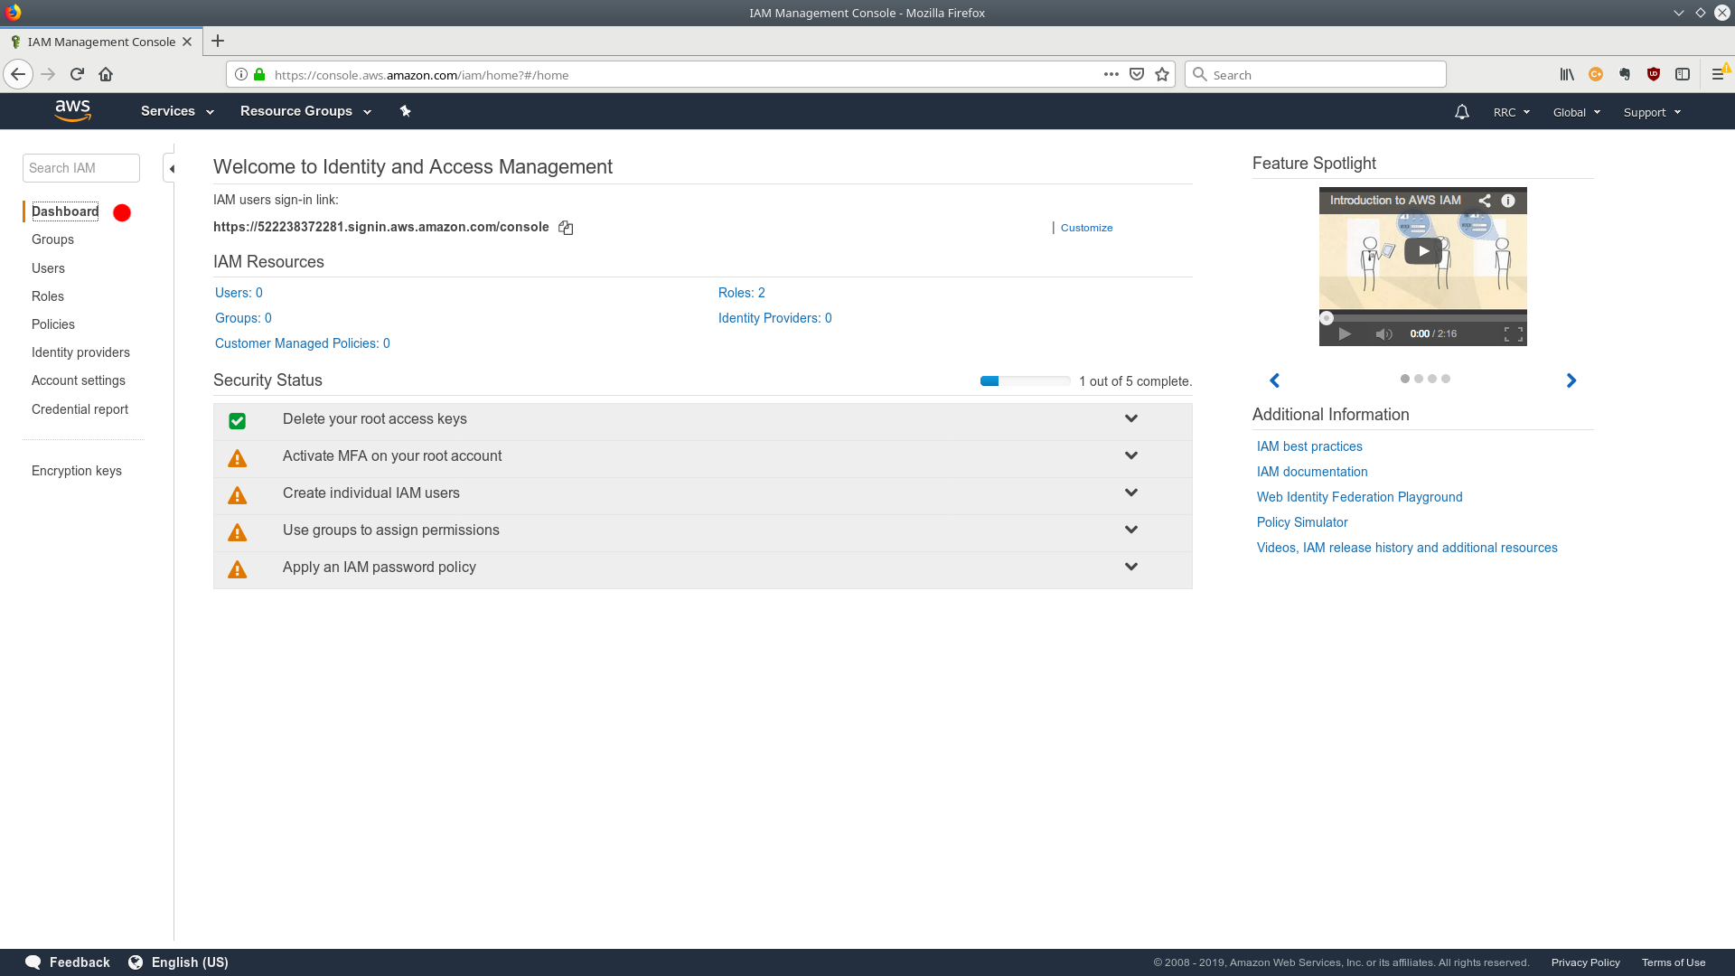
Setting up Users and Groups
You'll end up in the dashboard

Slide 4
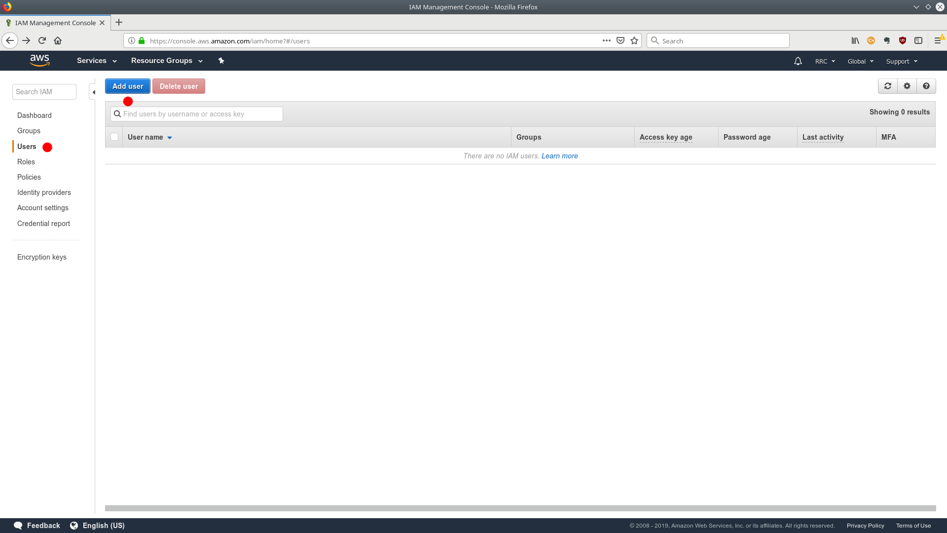
Setting up Users and Groups
Select "Users" from the left side bar
Click "Add user" at the top

Slide 5
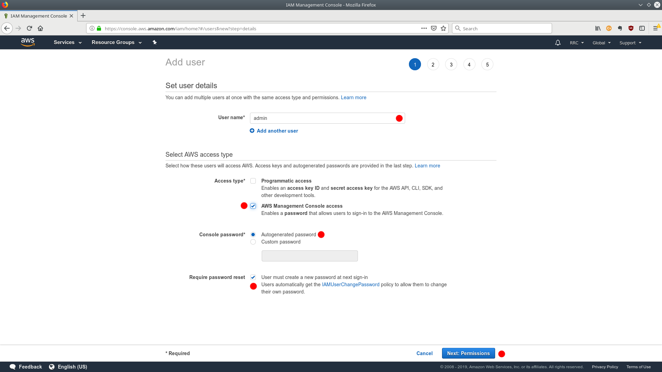
Setting up users and groups
Type "admin" as the user name
Choose "AWS management console access"
Choose "Autogenerated password"
Choose "User must create a new password at next sign-in"
Or, alternatively, choose your own password.
Click "Next: Permissions"

Slide 6
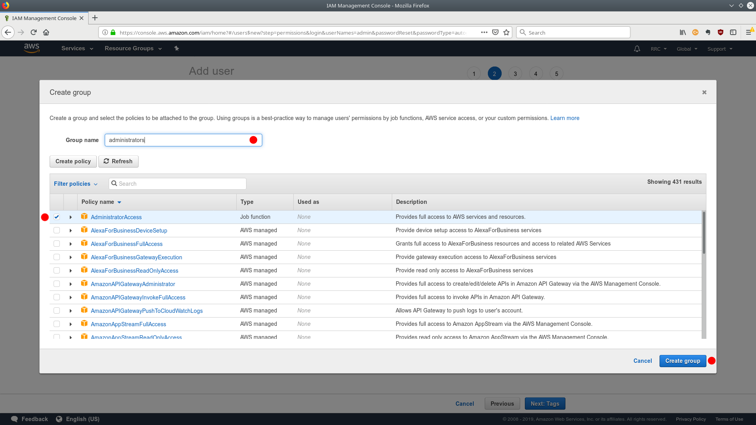
Setting up Users and Groups
Click "Create group"
Type "administrators" or "admins" in the Group name field at the top
Choose "AdministratorAccess" from the policies list
Click "Create group" blue button at the bottom right

Slide 7
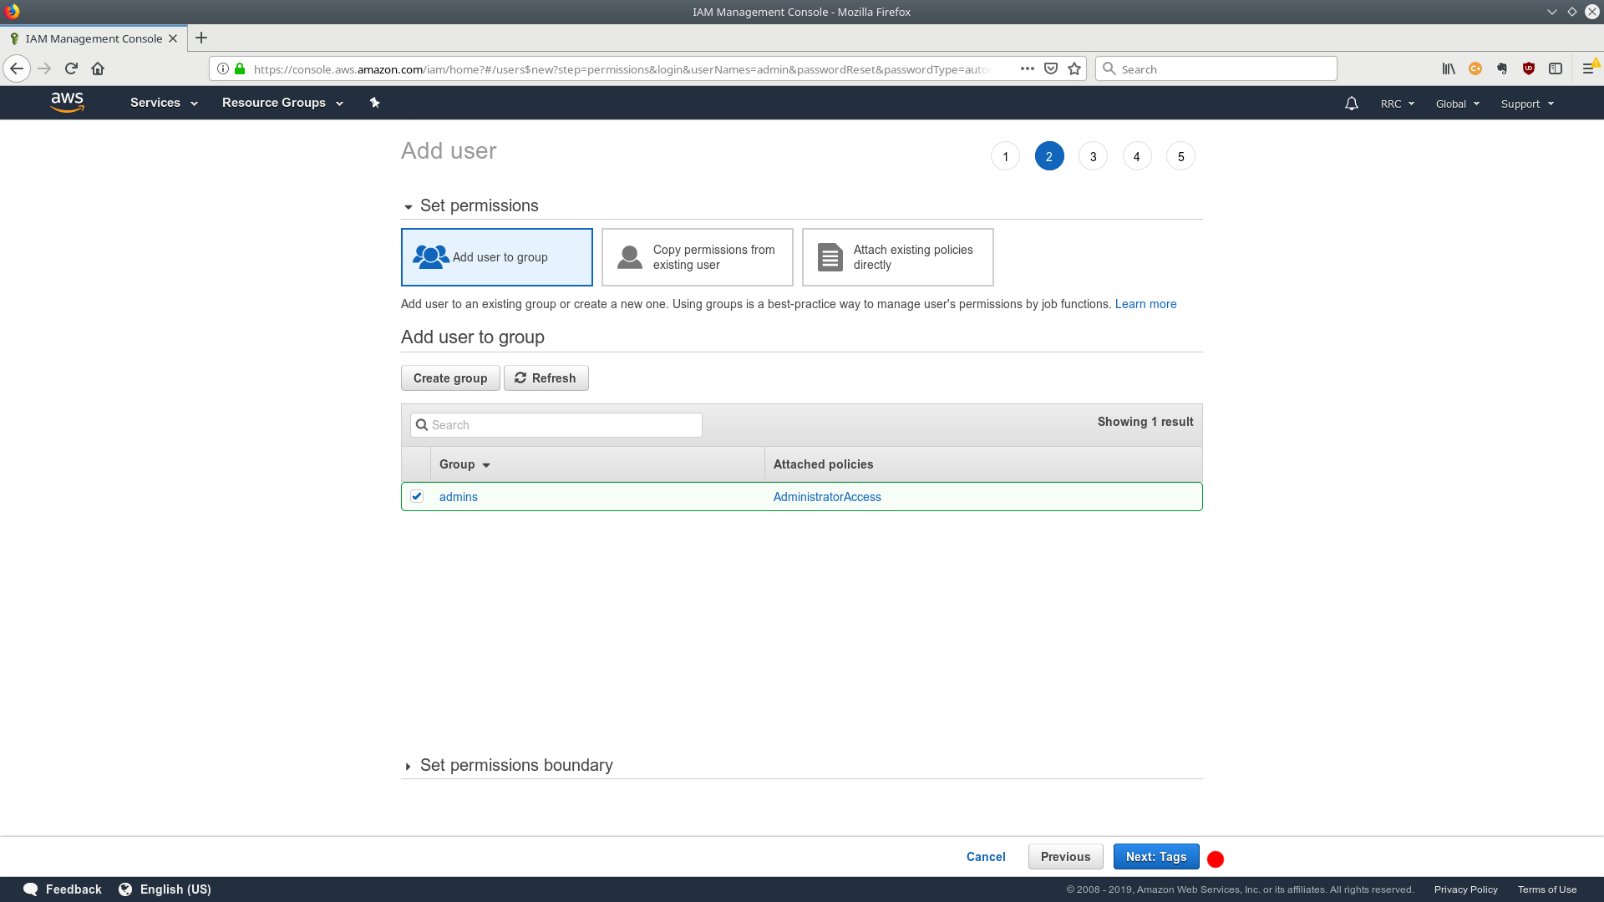
Setting up Users and Groups
You should now have a green group assigned to the user
Click "Next: Tags"

Slide 8
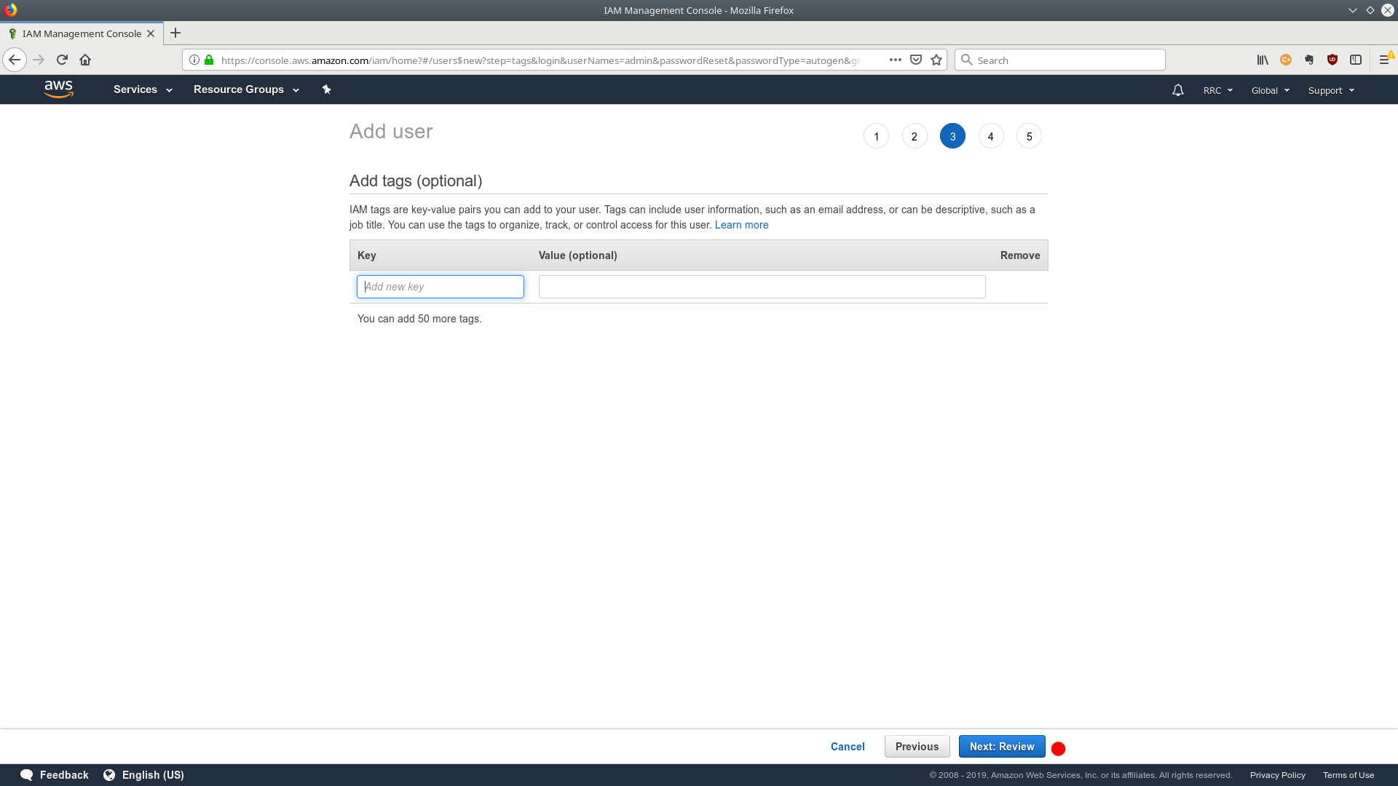
Setting up Users and Groups
You can skip this step
Click "Next: Review"

Slide 9
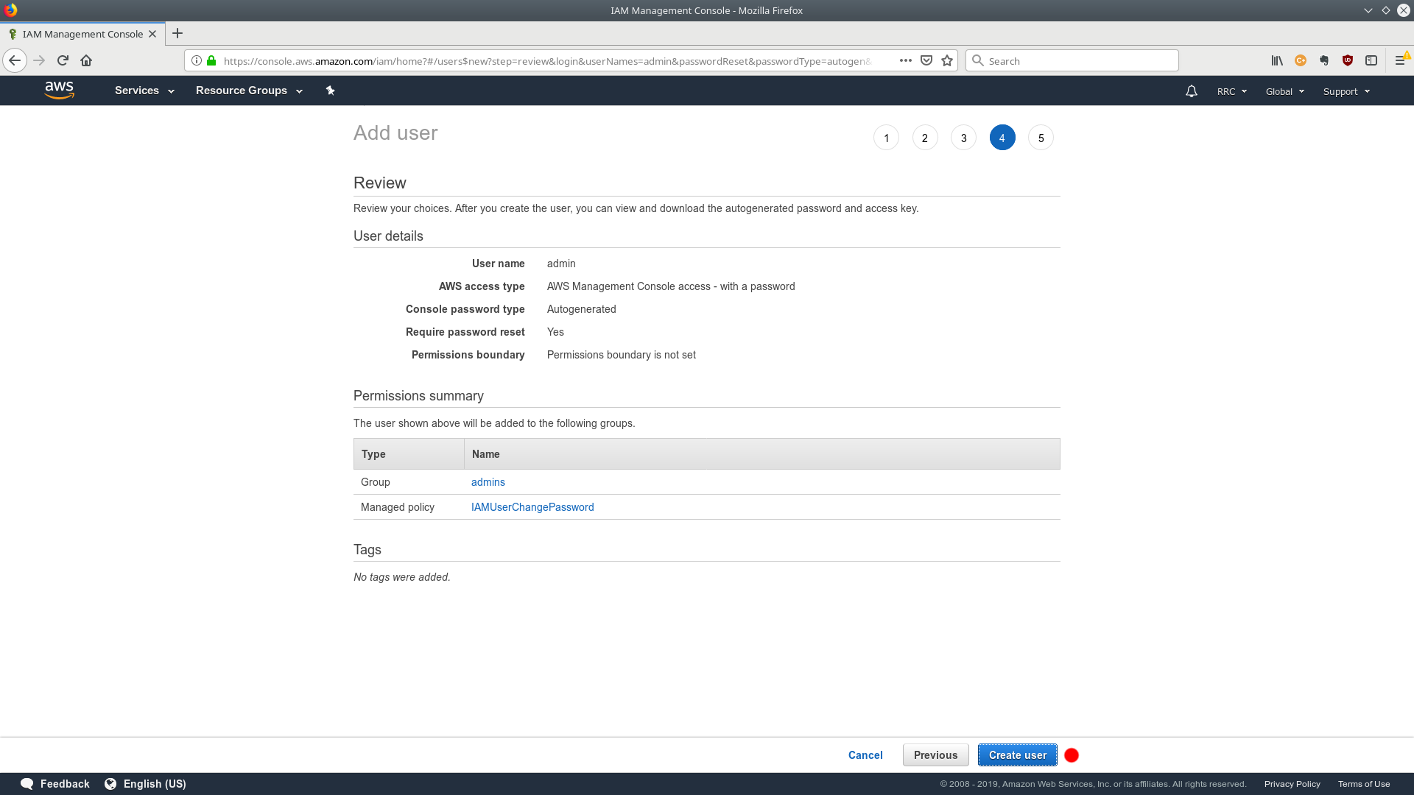
Setting up Users and Groups
Review the information for accuracy
Click "Create User"

Slide 10
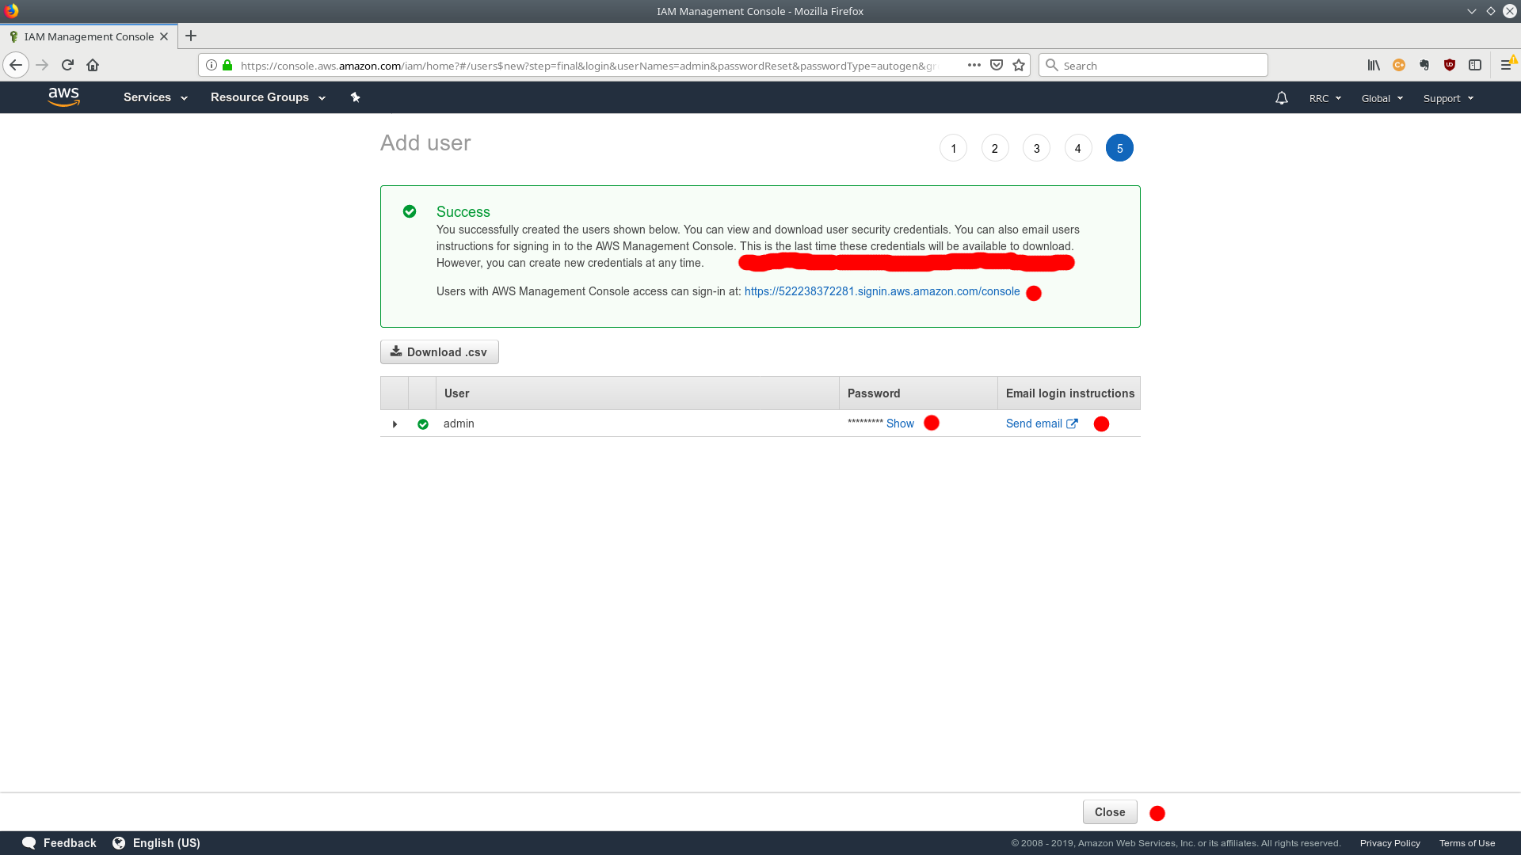
Setting up Users and Groups
Click "Show" underneath the password field to see your password
Take note of your password and also the sign-in URL
You may want to send yourself an email so you have the login information
Please note: this is the one and only time you'll get to see the password. If you don't write it down, you'll have to delete this user and recreate it

Slide 11
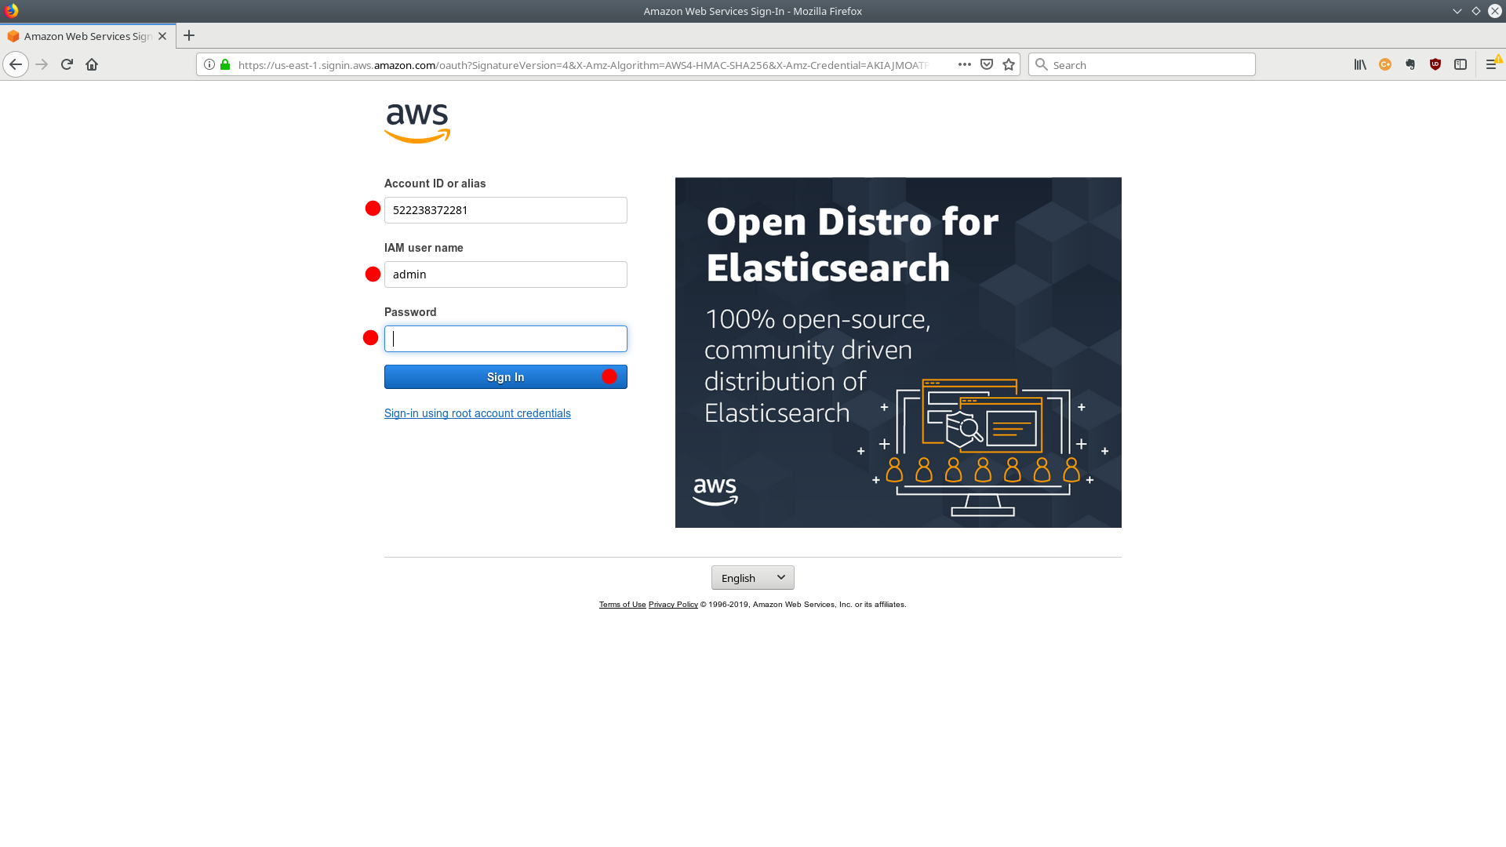
Setting up Users and Passwords
Logout and navigate to the URL that you noted in the last step
Sign in with your new admin user and password

Slide 12
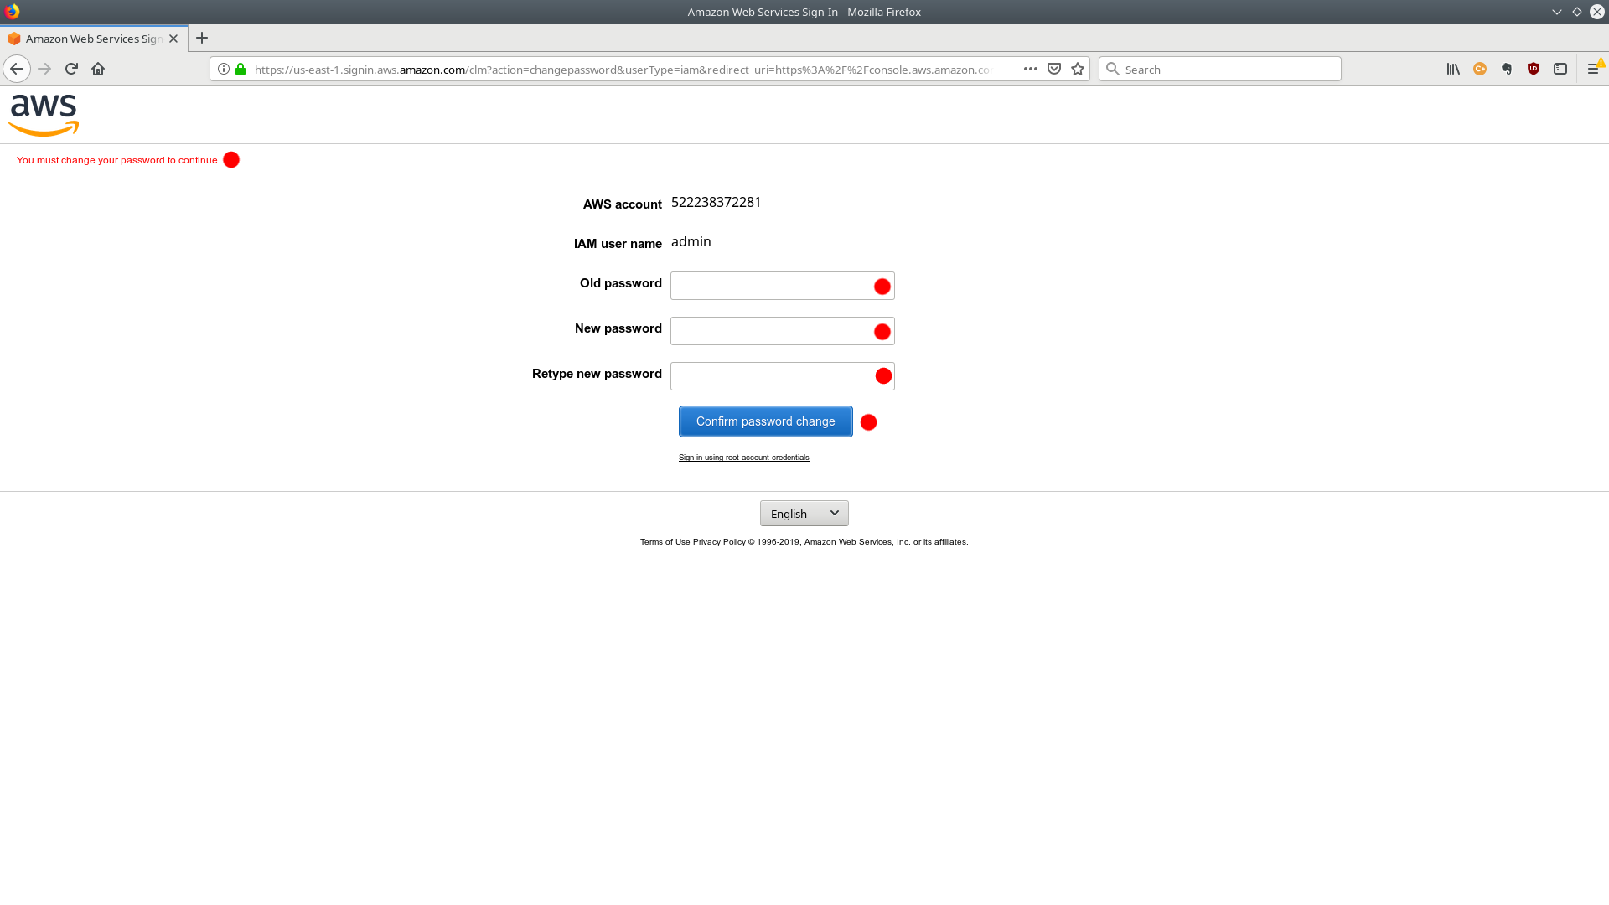
Setting up Users and Passwords
The first time you login, you'll be prompted to change your password

Slide 13
Setting up Users and Passwords
You should always login with your admin user, and not your root users account
Only the root account can access the billing console
It's good security practice to create users with only the permissions required to complete their task
Now you're ready to start using AWS services!

